Slide 1
Faculty feedback system
Prepared by-
Aabidhussain I. Agharia
Akshay S. Chavan
Ashutosh s. bhawsar

Slide 2
iNtroduction
The Student Feedback System is a management information system for education establishments to manage student data. Student Feedback Systems provide capabilities for selecting particular subject for feedback and generate the report automatically in a college. A Student Feedback System is an automatic feedback generation system that provides the proper feedback to the teachers as per the categories like always, poor, usually, very often, sometimes.
In the existing system students can give feedback about the lecturers by doing manually. By this process student can give feedback in system without wasting his time in writing. After giving feedback by every student papers are collected by the faculty and calculated the overall grade for each subject and each lecturer. After that those all grade report is viewed by the HOD which is given by the faculty. Hence estimating the performance of lecturers and giving feedback to college staff. So, the existing system carries more time to do a piece of work for this reason the online system feedback is implemented. This is the main disadvantage of the existing system for giving feedback about the lecturers and viewing report of lecturers manually. Student feedback on courses is an essential element in quality assurance.

Slide 3
Objectives
1) Decision making power is provided by this system.
2) Accurate result can be obtained.
3) This system makes Selection process more effective
4) To increase efficiency proposed system is depend on classification method.
5) Proposed system is used to reduce confusion at the time of processing feedback average.

Slide 4
Requirements
1. Functional Requirements:
a) JDK
b) 100MB of free space
c) Operating system: Windows 7 or newer/Ubuntu 14.04 or newer
2. Non-Functional Requirements:
a) Student/Teacher/HOD Login Information
b) Sufficient knowledge for genuine feedback.

Slide 5
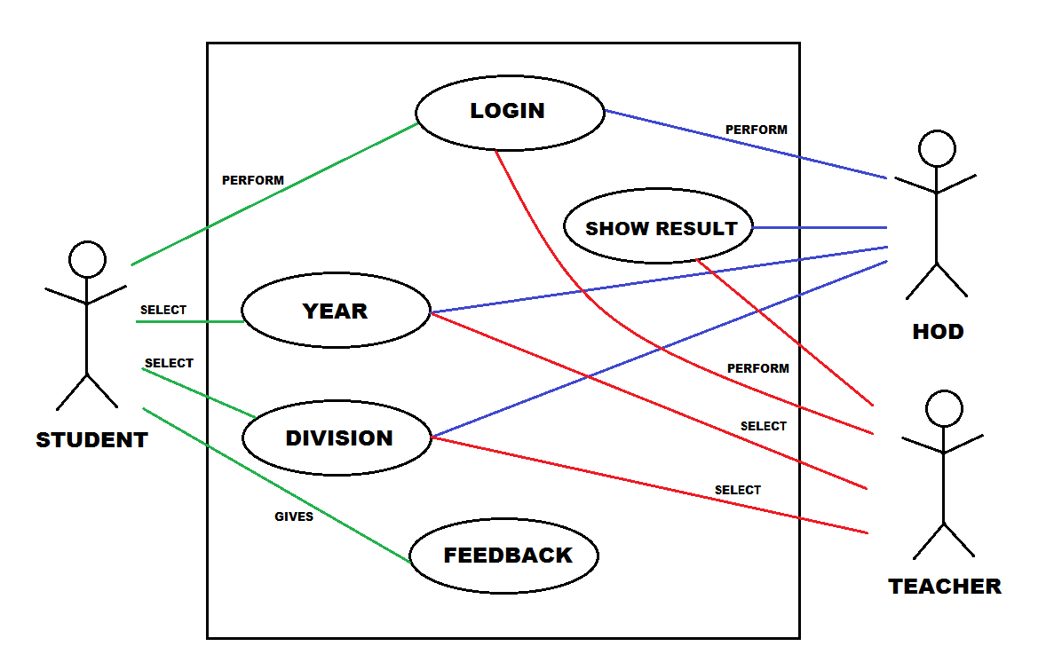
Use case diagram

Slide 6
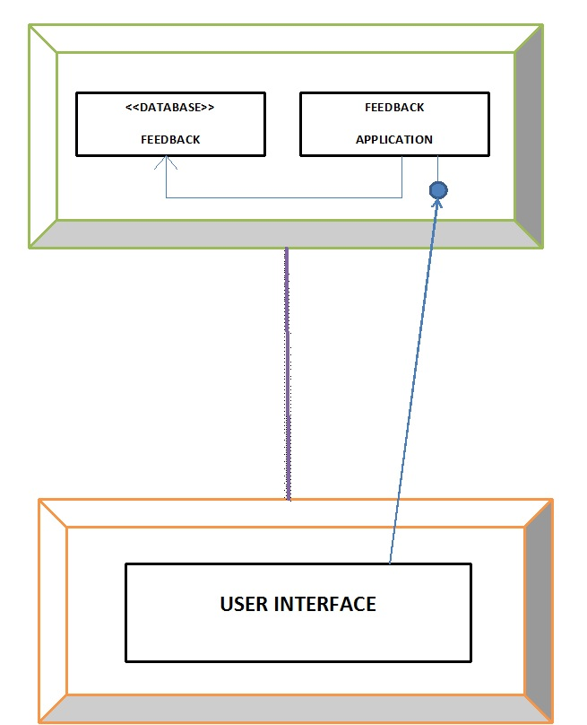
Deployment diagram

Slide 7
Conclusion
This project is design for the purpose to reduce the lecturer’s time and to reduce the burden of maintaining huge amount of records of students. At the time of feedback generation it apply formulae for generate a feedback of particular subject. After that it will displayed the whole record sheet to the staff, when the staff will login in the system.
As the comparison with Manual feedback or existing feedback system the new system is easier way to manage whole things in a particular manner. As per the existing system it is very easy process to save each and every record of individual student by the use of database.

Slide 8
References
Websites-
https://community.oracle.com/thread/2159150?start=0
https://www.youtube.com/watch?v=NoPzqahrzp8
https://www.tutorialspoint.com/sqlite/sqlite_java.html
www.stackoverflow.com
Book-
JAVA-THE COMPLETE REFERENCE by HERBERT SHIELDT.

